Slide 1
CAPSTONE PROJECT ON NEIGHBORHOOD OF TORONTO
By Promise Ekpo Osaine

Slide 2
Business Problem :
Toronto has many stores, restaurants, Coffee shops etc. The objective is to recommend the owner where to open the stores/restaurant. We shall try to find out the best neighborhood and store in Toronto using with Foursquare map..
Requirements
1. Foursquare developer account for API calls.
2. Need Neighborhoods with Latitude and Longitude
3. Knowledge of Data Analysis, Data Visualization,Data Processing and Machine learning algorithms.
4. Need Data for Toronto City.

Slide 3
Methdology
CRISP-DM – CrossIndustryStandardProcess for DataMining
The typical steps involved in CRISP-DM includes :
Business Problem
Data Understanding
Data Preparation
Modeling
Evaluation
Deployment

Slide 4
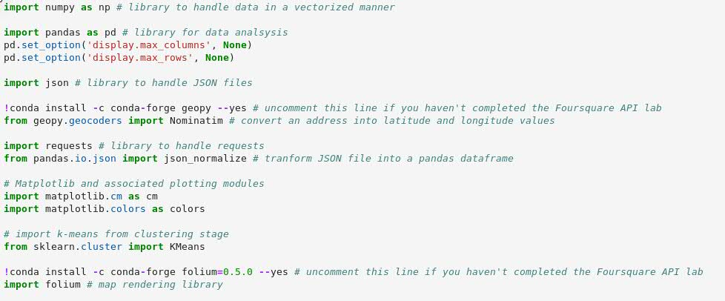
Required Python Libraries for this Project :

Slide 5
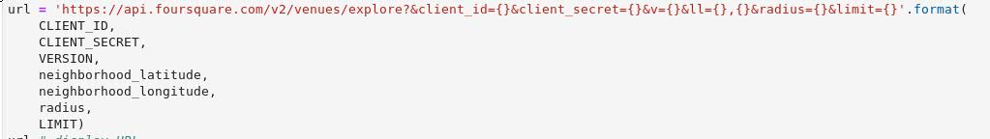
Required FourSquare Parameters :
Client Id, Client Secrete and Version of the URL.
From above URL, you have to mention Latitude and Longitude for specific city (Toronto).
Go through this URL
>> https://developer.foursquare.com/

Slide 6
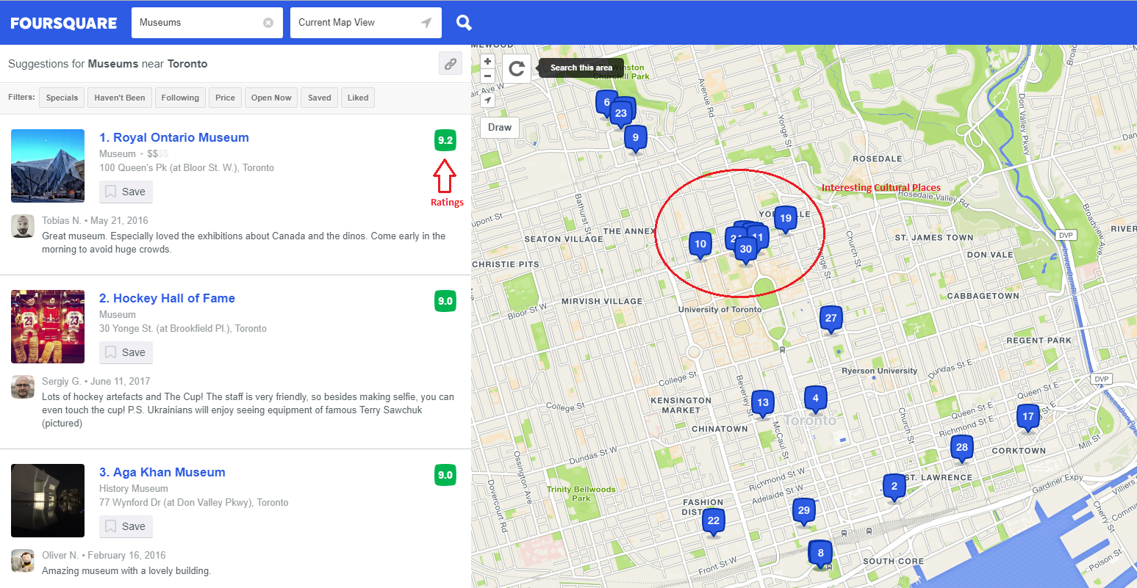
FourSquare Venues with ratings:

Slide 7
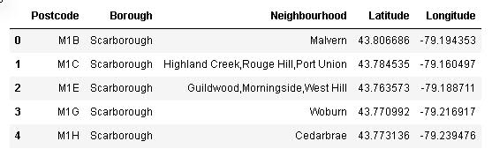
Toronto Data with Latitude and Longitude :

Slide 8
Data Understanding :
Things that matter :
– Is this Data sufficient ?
– What are the parameters required ?
– Is the problem Supervised or Unsupervised (Depending on the problem statement)
– Type of data we are dealing with i.e.,Text, Table format, Image, audio or Video
– What libraries are required for this project ?

Slide 9
Data PreProcessing :
Acquire the data using Pandas;
>> import pandas as pd
>> pd.read_csv(“path”)
We can read the different formats of data like .CSV, .xls, .html, .text etc.
Clean the data :
* Missing values
* Wrong data
* Duplicate values
* Normalize the data
* Data Conversion

Slide 10
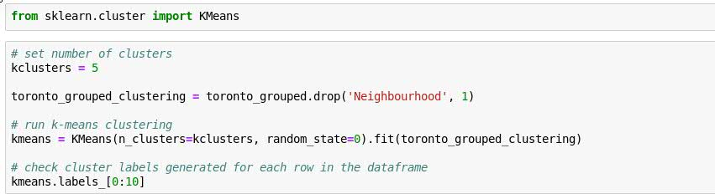
Data Modeling :
This Project is belongs to unsupervised mechanism. In this project we used K- Means clustering algorithm.

Slide 11
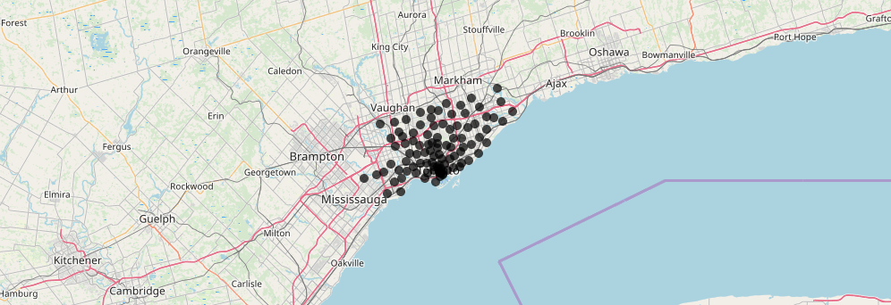
Data Visualization

Slide 12

Data Evaluation :
We have different types of Evaluation models
>> Train_test_split
>> Crossvalidation_Score
>> Metrics (Accuracy Score)
Example:

Slide 13
Deploy the Project :
Deploying Machine Learning into production is difficult. You need to:
>> Build and use the right cloud infrastructure on the right cloud provider
>> Design and implement public and internal APIs for model usage
>> Orchestrate a load of containers
>> Implement a load balancer to ensure you can scale to meet inference needs
>> Integrate with data pipelines and consistently update models

Slide 14
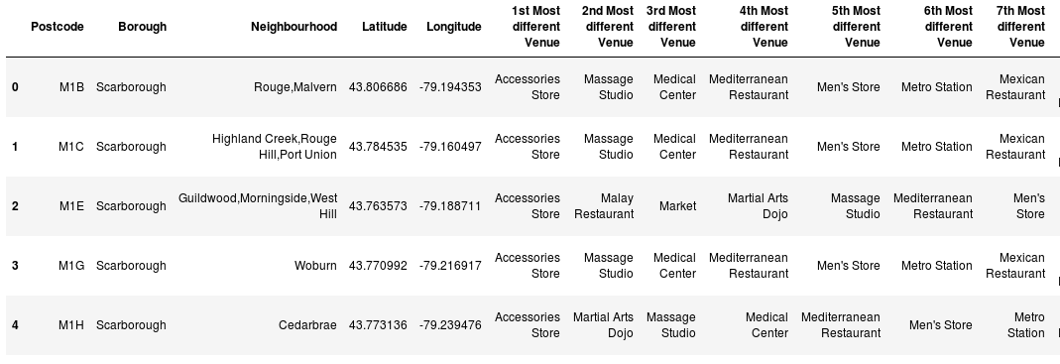
Result of Toronto

Slide 15
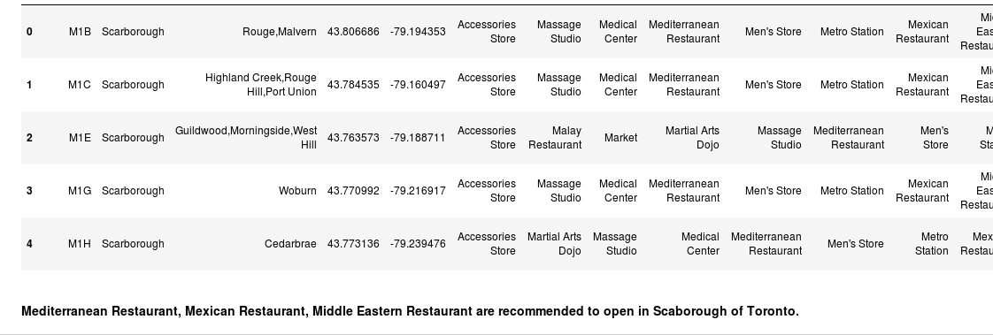
Discussion

Slide 16
Conclusion :
The analysis of this data is rather limited because we used only Foursquare. The ranking positions users’ ratings.
The Clustering function can be changed and will yield different clusters. We assumed 5, but stakeholders can change this at will.
Given the time allowed and the limited data, this was an interesting project that could very well benefit the Tourism agencies of Toronto!

Slide 17
Thank You

